Slide 1
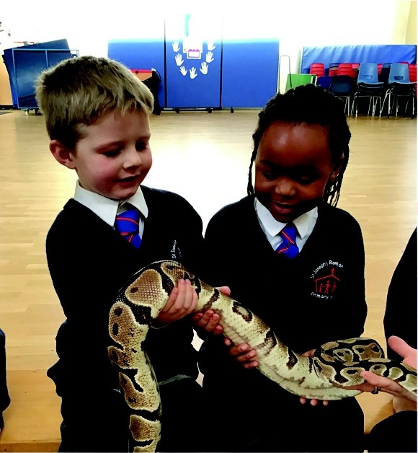
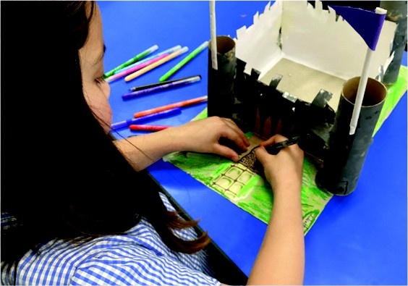
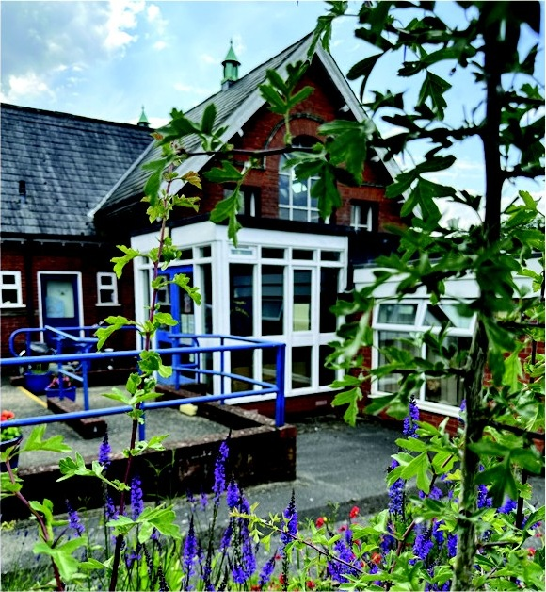

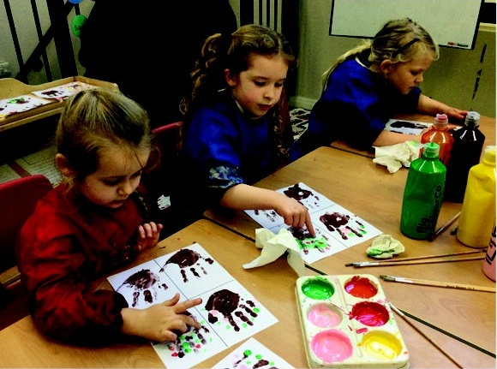
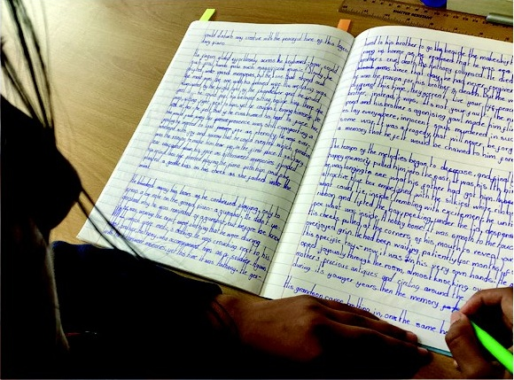
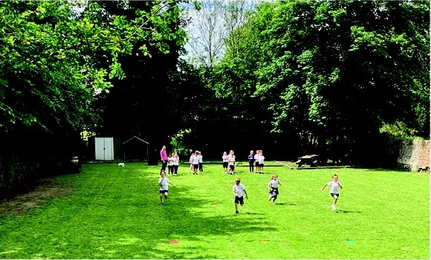
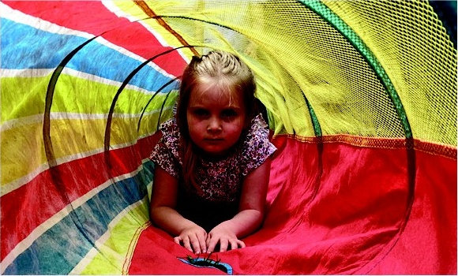
Open Morning
2026
St Joseph’s
Roman Catholic Primary School
2nd November
Encourage
and
Support
9:30am
A catholic school that warmly welcomes families of
all religious faiths or those with none.
A small family school providing an inclusive and welcoming community.
Wrap around care from 7.45am to 6pm each day.
An optional drop off service in the morning to avoid parking.
An academically inspiring curriculum catering for all children.
Musical instrument tuition, specialist French teaching, and opportunities to participate in sports competitions.
A variety of sports and extra-curricular clubs run by expert coaches.
Situated next to the Croft water meadows and river in the centre of Sudbury.
Email: admin@st-josephs.suffolk.sch.uk or Call: 01787 373365

