Slide 1
Dice games
Dice games are great for a variety of reasons:
They are versatile and can be played with any number of players, on the floor, at a table and with people of any age. You can even arrange to play these games with family members who do not live in your house, for example while using Facetime or Skype!
They teach numbers, counting and quick mental recall of number facts.
They teach social skills such as taking turns and winning and losing.
They introduce children to strategic thinking and planning.
They are great fun! Enjoy!

Slide 2
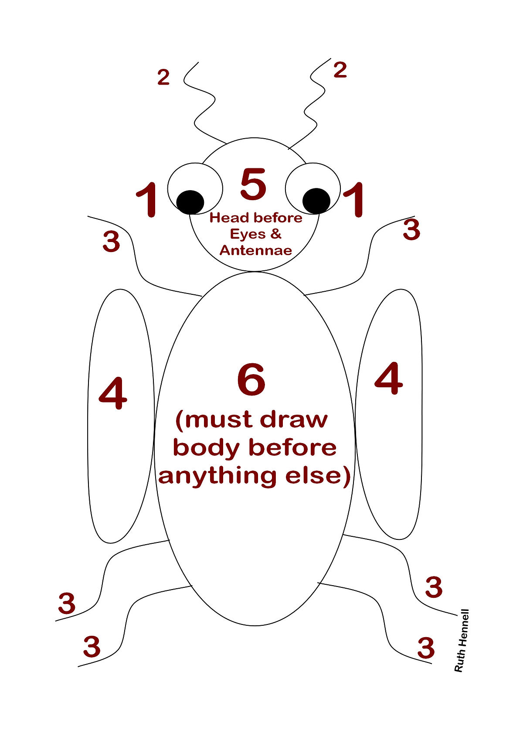
Beetle Drive
You will need: A dice, a pencil and some paper.
Aim of the game: To be the first person to draw a complete beetle.
How to play: Players take it in turns to roll the dice and draw body parts of the beetle depending on the number they have thrown.
There are 14 body parts to draw – a body, a head, six legs, two wings, two eyes and two antennae.
You must throw a six to start to draw the body.
Throw a five – draw the head
Throw a four – draw the wings
Throw a three – draw a leg
Throw a two – draw an antennae
Throw a one – draw an eye
You must draw the body before anything else, so you can’t start until you throw a six.
You must draw a head (five) before you can draw the eyes and antennae.
It doesn’t matter what your beetle looks like!
The first player to draw a complete beetle shouts ‘BEETLE’ and scores the maximum 14 points for that round.
Everyone else counts up how many body parts they have drawn, and scores one point per body part.

Slide 3
Knockout
You will need: Two dice
Aim of the game: To avoid throwing certain scores and being knocked out of
the game.
How to play:
Each player chooses a “knock out number” – either 6, 7, 8, or 9. More than one player can choose the same number.
Players take turns throwing both dice, once each turn. Add the number of both dice for the score.
If a player throws a 6, 7, or 8, they are knocked out of the game until the next round.

Slide 4
Beat that!
You will need: 2 for younger players and 7 for older players
Aim of the game: To make the highest number.
How to play: Each player takes a turn rolling the dice and placing them in order to make the highest number possible. For example, if a player throws a two and a three, they have 23. A player who throws a six and a four would win the round as they have the higher number - 64. After each throw, a player challenges the next player, “Beat that!” Play this game in rounds, giving a winner to each round.
Variations: Try making the smallest number possible.
Use three dice for play.
Instead of playing in rounds, set a score, to reach to win the game.

Slide 5
Going to Boston
You will need: 3 dice
Aim of the game: To roll the highest total
How to play:
Roll the dice and keep the highest.
Roll the remaining dice and again set aside the highest.
Roll the last dice, and add up your total. Write down your score.
If a player rolls the highest total for a round, they win the round. Keep score and the player who wins the most turns wins the game.
Keep totalling each player’s score and the player who reaches a target number (e.g. 100 points) first wins.
Variations: Multiply the dice to get the score.
Use two dice or more than three dice.

Slide 6
Stuck in the mud
The fun of this dice game is the unpredictability. Some turns end immediately and some seem to go on forever. Players can only score on a roll which does not include the numbers 2 and 5. Any dice, which show a 2 or a 5, become “Stuck in the mud!”
You will need: 5 dice
Aim of the game: To roll the highest score.
How to play:
The first player rolls all five dice. If any 2s or 5s are rolled, no points are scored for this throw. If no 2s or 5s are rolled, add up the total of the dice and write it down.
The player sets aside any 2s and 5s, and throws the remaining dice. Again, if any 2s or 5s are thrown, no points are scored. If there are no 2’s or 5s, add the total to the previous score.
Continue in this way until all the dice are “Stuck in the Mud.” After the score is totalled, play passes to the left.

Slide 7
Round the Clock
You will need: 2 dice
Aim of the game: To go ‘round the clock’ by throwing all the numbers from 1 to 12 in order
How to play:
Each player rolls the dice. The player with the lowest total goes first.
The first player throws both dice, hoping to throw a 1. Players then take turns (in a clockwise direction) trying to throw a 1.
On the next round, those players who threw throw a 1 will try to throw a 2. Players can do so by throwing a 2 or two 1s. Any player who did not throw a 1 in the first round will try again this round.
Play continues round-by-round with players trying to throw all the numbers from 1 to 12 in sequence. Players may count the spots on just one die or on both dice added together. For example, throwing a 3 and a 6 could be counted as 3, 6, or 9.
The first player to go “Round the Clock” – throw all the numbers from 1 to 12 in order – wins the game.

Slide 8
Pig
The game is called “Pig” because the first player “hogs” the dice in an effort to win the game.
You will need: 1 dice
Aim of the game: To score 100 points or more (or whatever you choose your target number to be)
How to play:
The first player rolls the dice and adds up the numbers after each roll. They may stop rolling at any time and end the turn.
The player loses all points for the turn when a 1 is rolled.
If the first player gets to 100 points on their first turn, the other player(s) may take their turn to try to achieve a better score.

Slide 9
Passage
You will need: 2 dice
Aim of the game: To be the first player to reach 11 points
How to play:
To set up the game each player rolls a die. The highest scoring roll will be the player who begins the game. The player who rolled the lowest number will now roll a second time and the number on the die becomes the “point number.”
Starting with the first player, players take turns rolling two dice. If he rolls the point number, he gets one point. If he rolls doubles of the point number he gets two points. Each player gets only one roll per turn.
The first player to get 11 points wins.

Slide 10
Fifty
You will need: 2 dice
Aim of the game: To be the first player to reach 50
How to play:
Taking turns, players roll two dice, one roll per turn. If they do not roll doubles, they do not score for that turn.
If they roll doubles, they earn a score as follows:
Double 1s, 2s, 4s, 5s = 5 points
Double 6s = 25 points
If they roll double 3s, their score up to that point is wiped out and they must restart accumulating points.
The first player to reach 50 points wins.

Slide 11
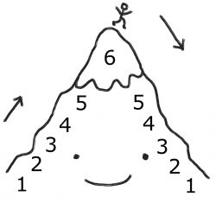
Mountain
You will need: 2-3 dice, pencil, paper
Aim of the game: To be the first to climb up and come down the mountain!
How to play:
A mountain is drawn on a piece of paper with a series of numbers leading up the mountain, and going down the other side. In order to climb the mountain, children must roll each number that is shown on the mountain, in order. So if the first number is a 1, then a 1 must be rolled before climbing! Each number must be rolled in order, so there can be no jumping up the mountain if they roll a number that appears later on. The winner is the first person that is able to get up and over the mountain with a series of successful dice rolls. The best thing about this game is that it can be tailored for different players. For example, you may want to increase the size of the mountain, allow dice totals to be added up, or introduce more dice!

