Slide 1
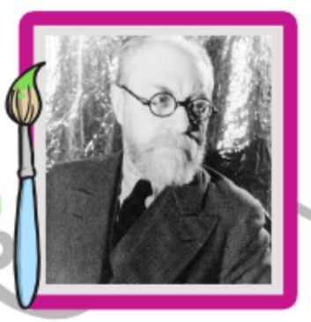
Henri Matisse
1869-1954

Slide 2
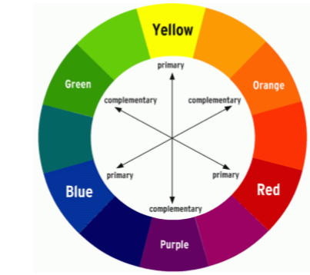
Henri Matisse
Henri Matisse is a French artist famous for his use of bright colours and cut and torn paper.
He particularly likes to use complementary colours that contrast with each other more than other colours and when put side by side, make each other look even brighter.

Slide 3
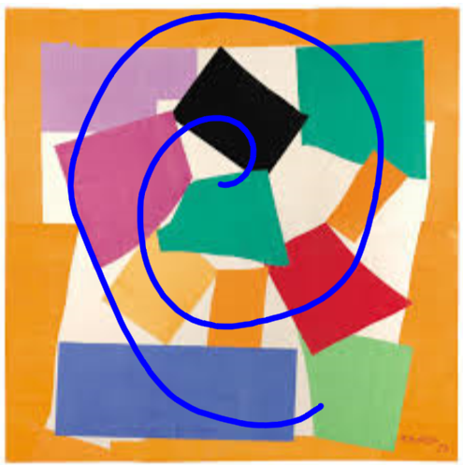
The Snail
He has arranged the paper in a spiral
shape like a snail's shell.
Does it look exactly like a snail?
It is a representation, not a realistic
still life picture.

Slide 4
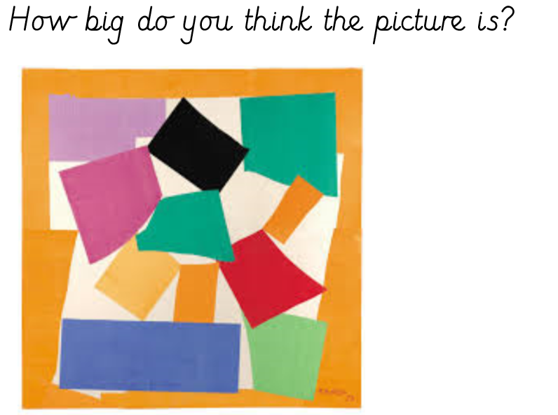

Slide 5
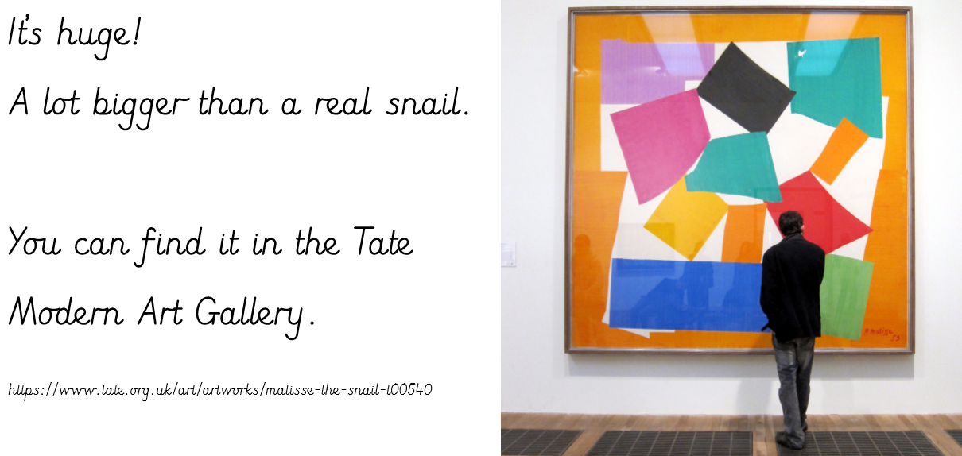
https://www.tate.org.uk/art/artworks/matisse-the-snail-t00540

Slide 6
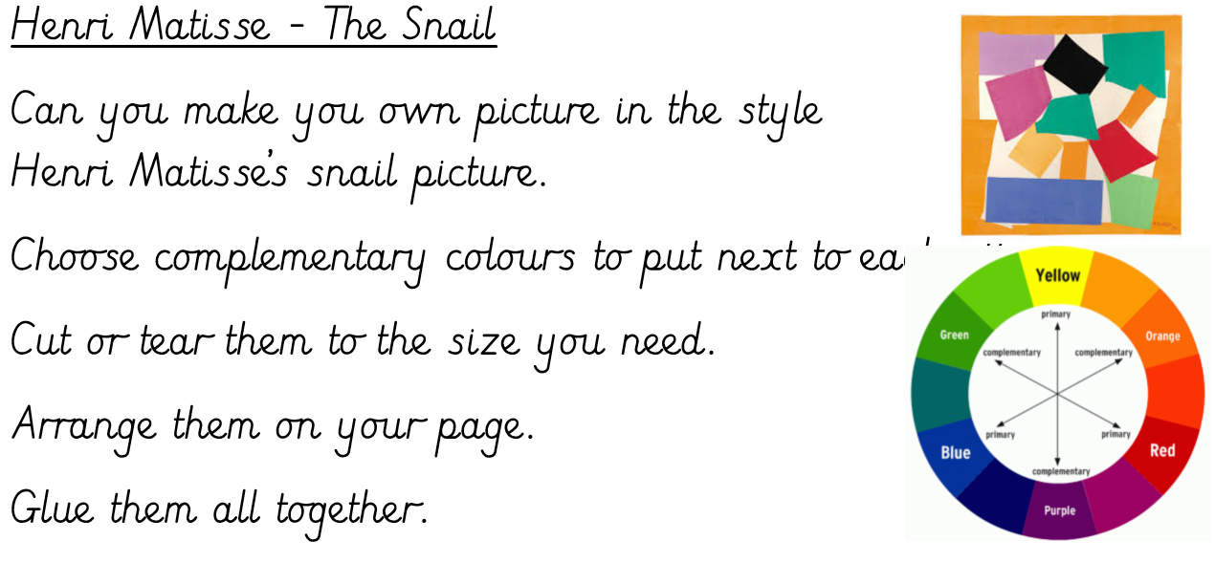

Slide 7
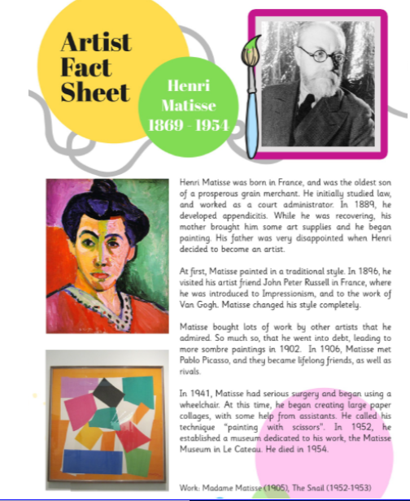

Slide 8
Can you find out any more information about Henri Matisse?
History – make a timeline of key events.

