Slide 1
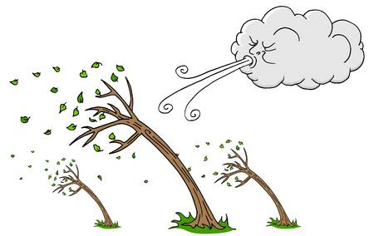
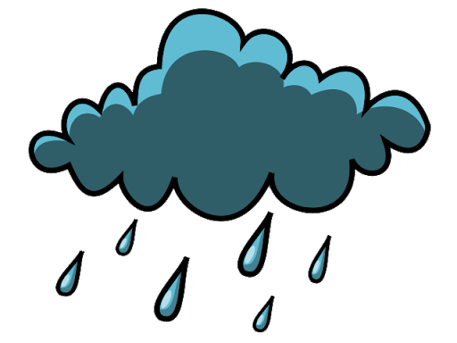



Weather poems
Click on the speaker symbols and listen to the poems.
Listen to them a few times and join in where you can.
Maybe you could add actions or sound effects!

Slide 2

The Wild Wind
By John Foster
Sweeping down the street,
Swerving through the trees,
Snatching leaves and twigs
To whisk in its breeze.
Whistling round the chimneys,
Whooshing under floors,
Sniffing at the windows,
Snapping shut the doors.
Shattering the silence
Wherever it goes,
Swirling, twirling, whirling,
The wild wind blows.

Slide 3
Weather sense
By Eric Finney
See the lightning
Split the sky.
Hear the thunder
Rumbling by.
Feel the wind
Bringing rain.
Smell the world
Washed clean again.
And now it’s clear
The storm is done -
Taste a strawberry
Warmed by sun.

Slide 4
A Sense of Weather
By Moira Andrew
I love the sound of rain
splishing and splashing
in grey-gurgly gutters.
I love the feel of sunshine
blazing and blistering
on hazy summer days.
I love the taste of snow
melting and mingling
on the tip of my tongue.
I love the look of rainbows
glittering and glistening
across a sun-stormy sky.
I love the smell of frost
frizzling and frazzling
on ice-sparkly mornings.

Slide 5
The music of the wind
By Wes Magee
The wind makes LOUD music.
It roars above the rooftops,
it drums beneath the floor,
it howls around the gable-end
and rat-a-tats the door.
The wind makes quiet music.
It whistles down the chimney,
it tiptoes through a tree,
it hums against the window-pane
and whispers tunes to me.

