Slide 1
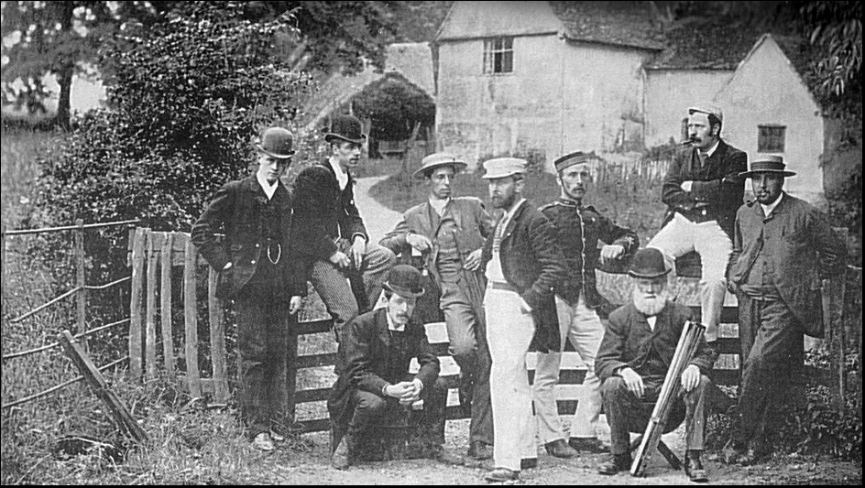
Willy Lott’s Cottage
1890 The cottage was quite run down.

Slide 2
Who was Willy Lott?
Willy Lott was a farmer who lived between 1761-1849. He rented a cottage near to the farmland which became know as Willy Lott’s cottage.
He was born in the cottage and so were his brothers and sisters.
Although he could not read or write, Willy made enough money to buy the house and farmland 1825. He never married, lived with his sister Mary and he died in the house at the age of 88 leaving the farm to his sisters and brother and their children.

Slide 3
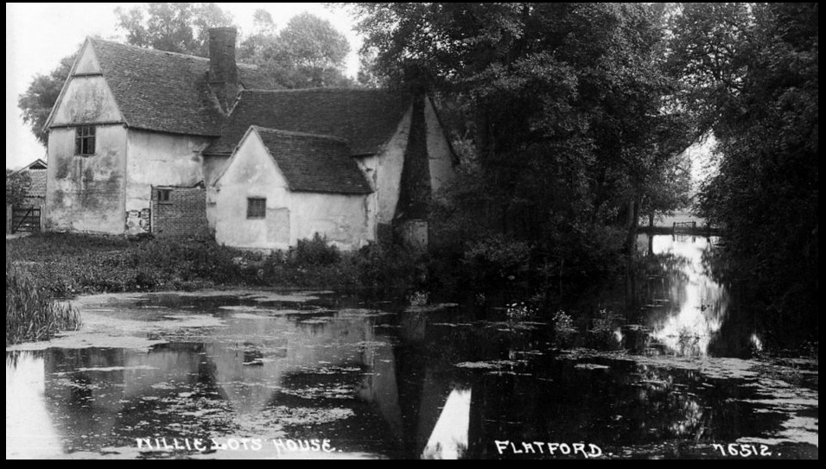
1926 - still quite run down.

Slide 4
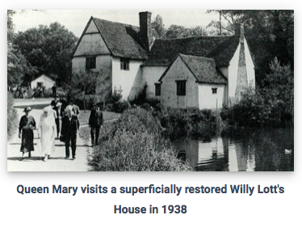

Slide 5
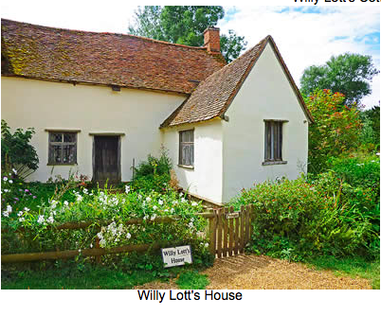
Willy Lott’s cottage – now.

Slide 6
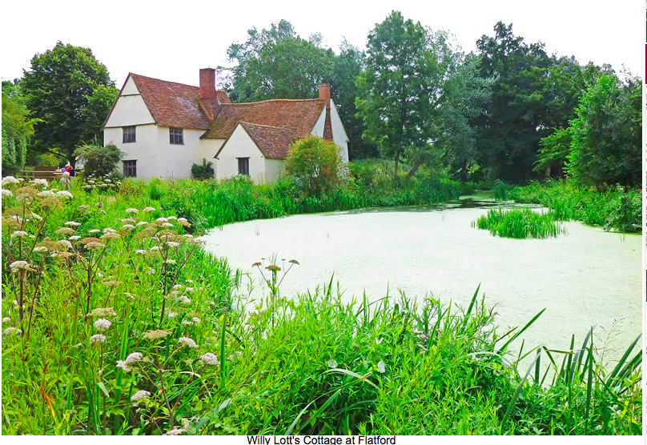

Slide 7
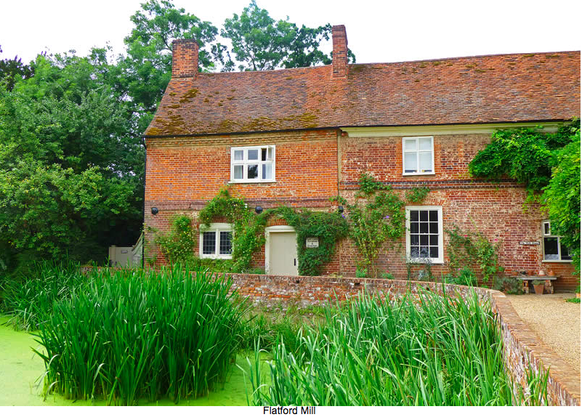

Slide 8
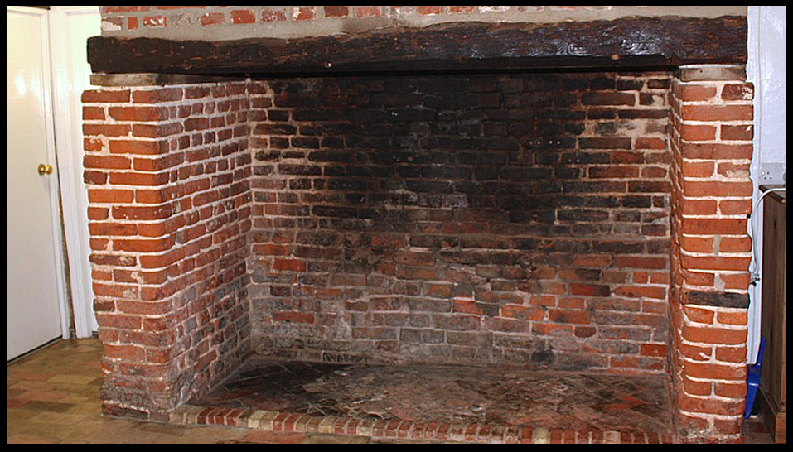
Huge fireplace inside Willy Lott’s Cottage.

Slide 9
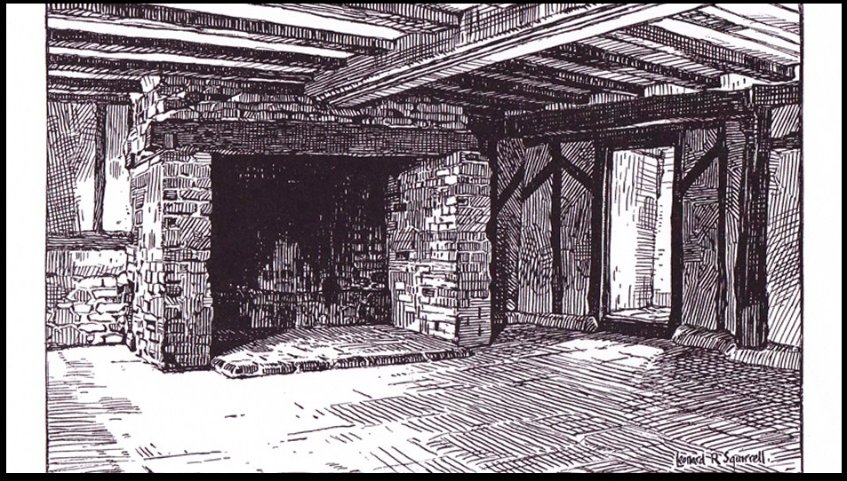
1928 – Drawing of Willy Lott’s fireplace by Leonard Squirrel.

Slide 10
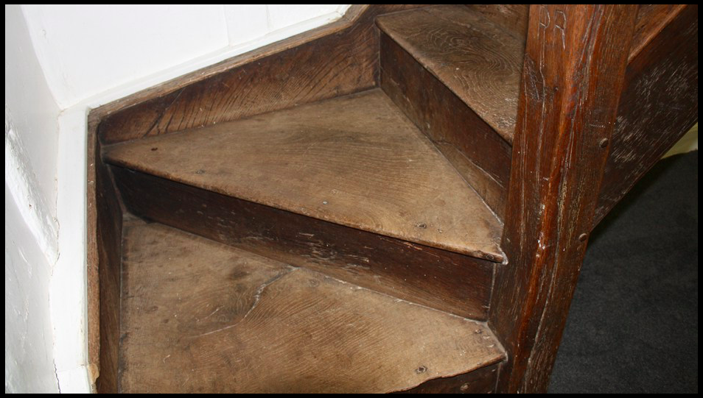
Winding staircase in Willy Lott’s cottage.

Slide 11
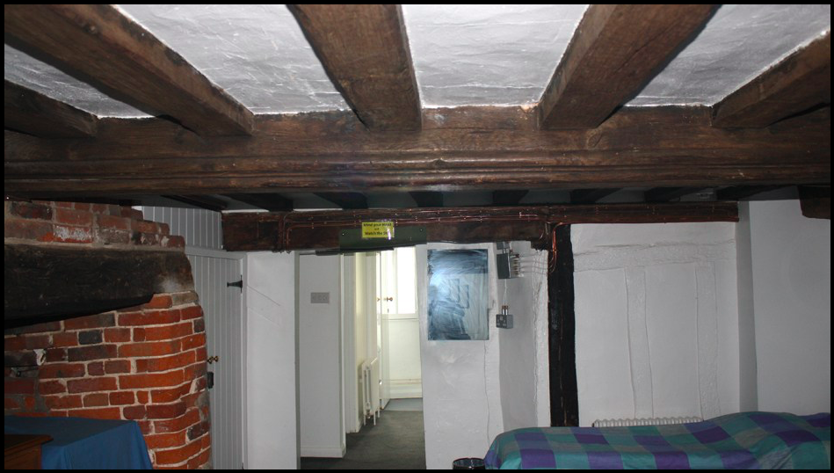
Very low ceilings in Willy Lott’s Cottage.

Slide 13
Life on the farm.
One fireplace with wood or coal would heat the whole cottage. There was no electricity
There were no fridges so food had to be eaten straight away.
You had to go outside to go to the toilet. At night you had to wee in a pot and
empty the pot in the morning.
A bath was maybe once a week and water had to heat up over the fire. It was easier to jump in the river.
Clothes were all handmade and were passed on and patched up.

Slide 14
There were no ovens. Bread, milk, eggs, cheese and beer were the basics that
most people lived on. Meat wasn’t eaten very often and animals were kept for
food.
Bread was baked in a bread oven made of brick. Wood was burnt at the
bottom to make it hot enough. You had to pick ash out of your bread.
Drinking water came from a well, stream or river and was collected in pots.
Breakfast was a poor porridge of flour, butter and water. At midday they would eat
bread and occasionally a piece of cheese. Supper was bread or potatoes and
sometimes a piece of bacon.
People got up with the sun and went to bed with the sun.
They worked 6 days a week.
Even children worked hard on the farm from as young as six years old. Boys would scare the birds from the crops, stop the animals from straying, pick hops, sow potatoes
and beans, gather mushrooms and herd animals to market.
They would also collect firewood, fill sacks with grain and shred turnips.
As they got older they would progress to ploughing and other hard physical tasks.
At harvest time everyone lent a hand making hay or harvesting crops.

Slide 15
This is how the washing
was done.

Slide 16
Clothes were squeezed
through a mangle to
get rid of some of the
water. Then clothes
were hung outside to dry.

Slide 17
Have a go at drawing pictures to show the differences between how Willy Lott and his family lived compare to now. Think about clothes, food, washing, work and school.

