Slide 1
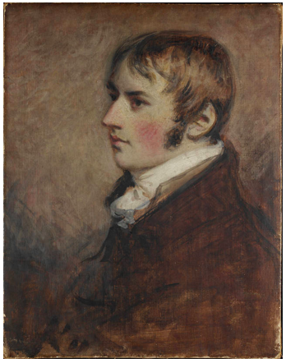
John Constable 1776 - 1837

Slide 2
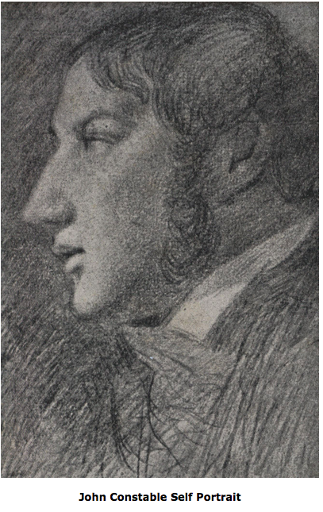
Constable’s father owned a mill. His brother was disabled so Constable was expected
take over the mill and run it but he didn’t do this for long as he wanted to be a
painter. His friends gave him money so that he could keep painting.

Slide 3
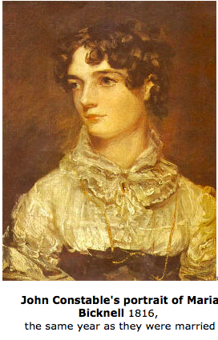
Constable had 7 children.

Slide 4
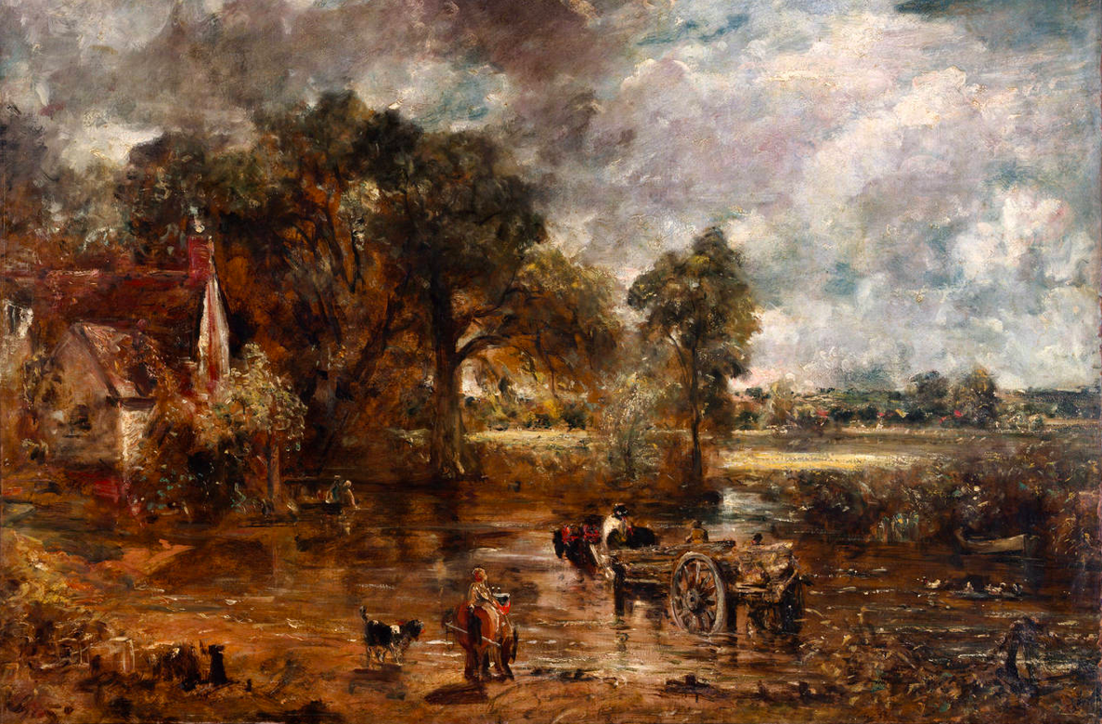
Practising for painting ‘The Haywain.’

Slide 5
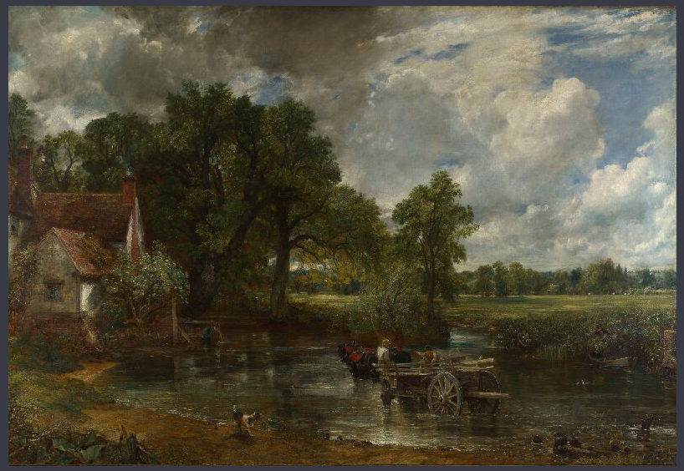

Slide 6
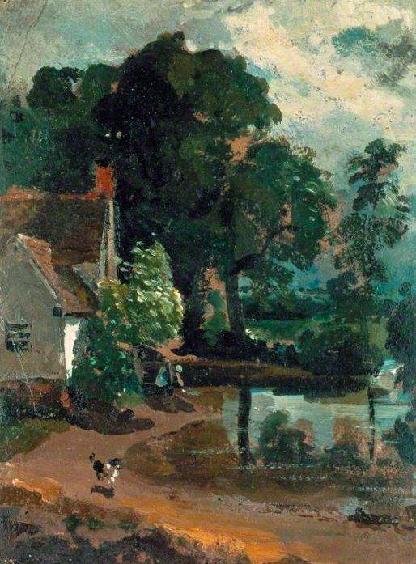
Willy Lott’s Cottage.

Slide 7
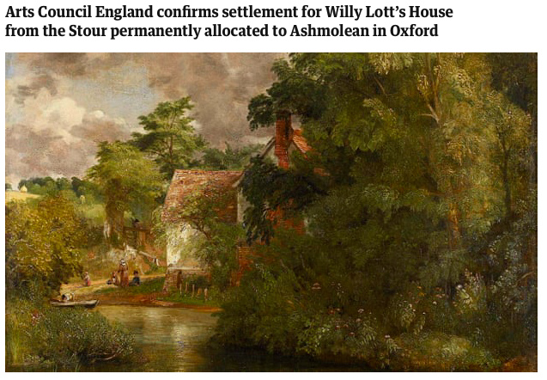

Slide 8
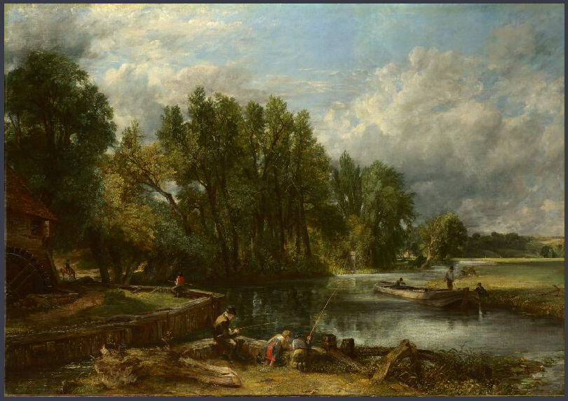
Stratford Mill - 1820

Slide 9
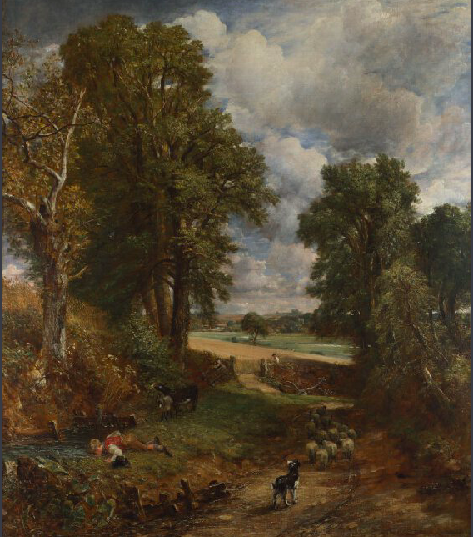
The Cornfield - 1826.

Slide 10
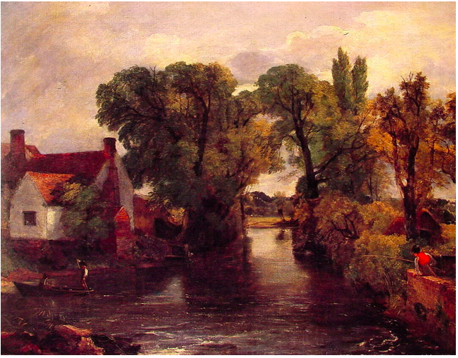
The Mill stream – then.

Slide 11
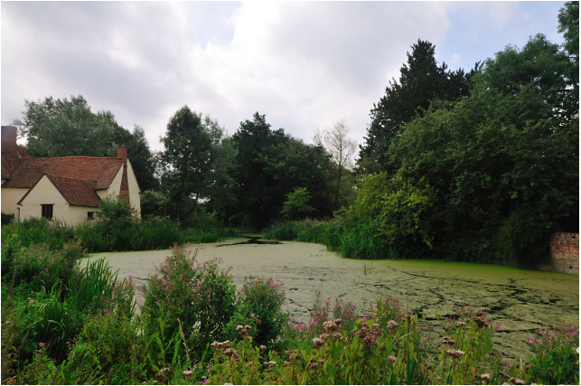
The mill stream – now.

Slide 12
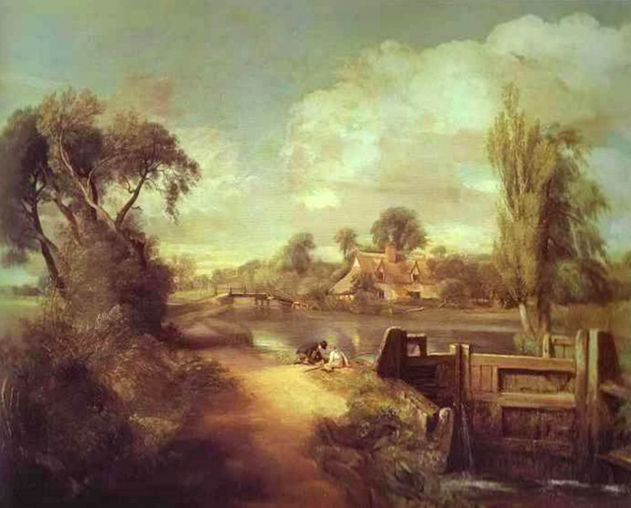
Two boys fishing - then.

Slide 13
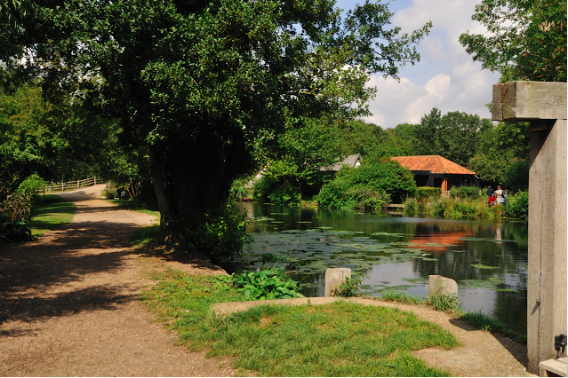
Two boys fishing - now.

Slide 14
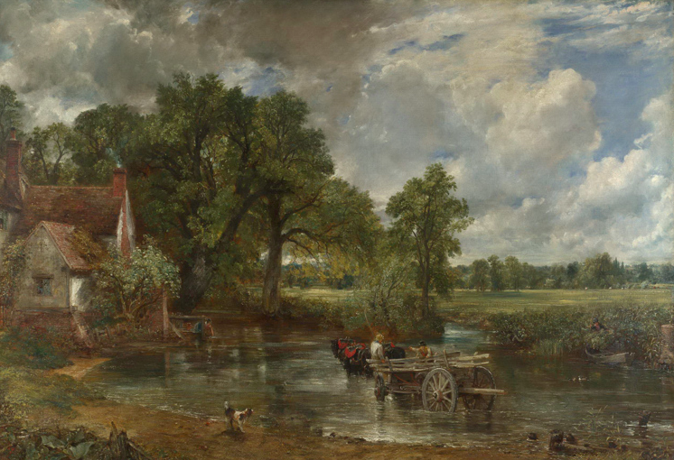
The Haywain – then. (1821)

Slide 15
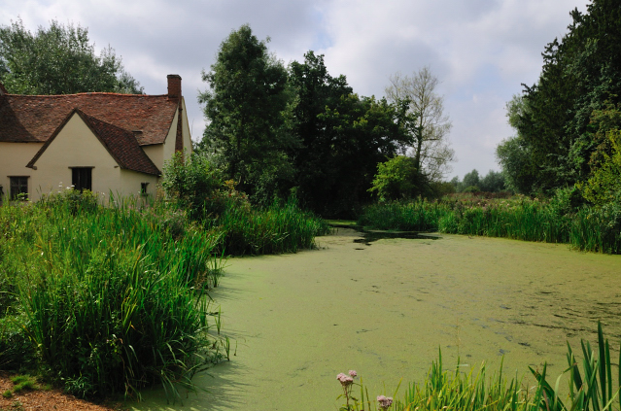
The Haywain - now (2018.)

Slide 16
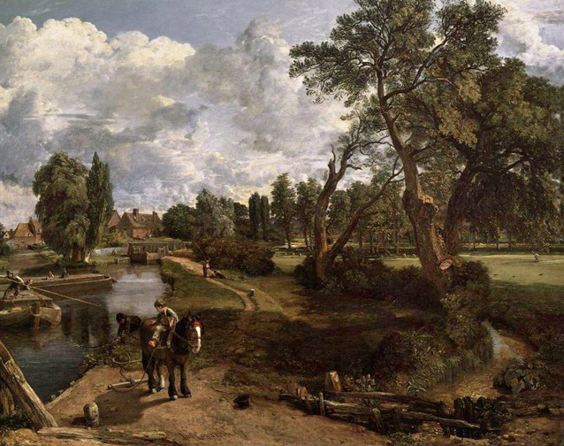
Flatford Mill - then.

Slide 17
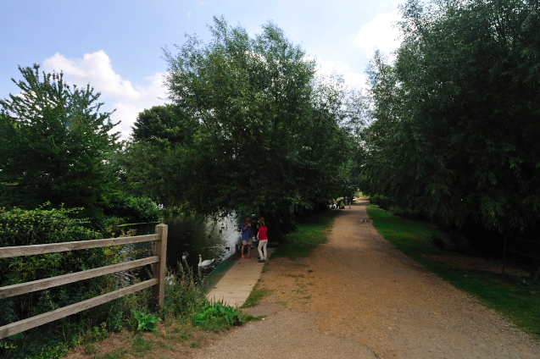
Flatford Mill - now.

Slide 18
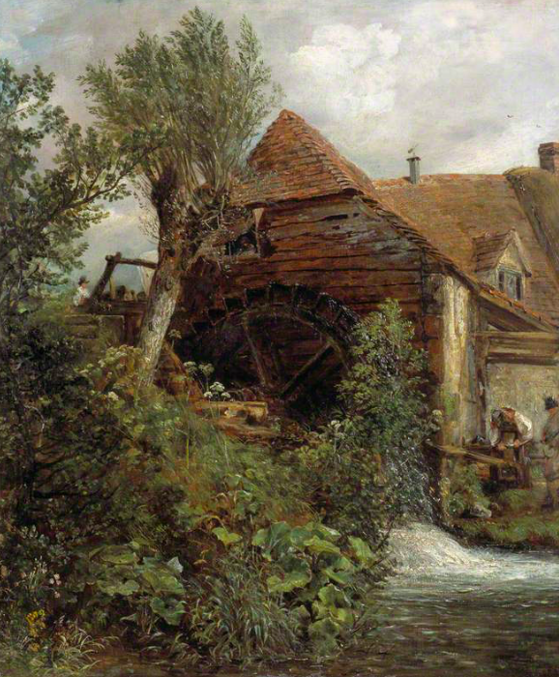
Other paintings by Constable…..

Slide 19
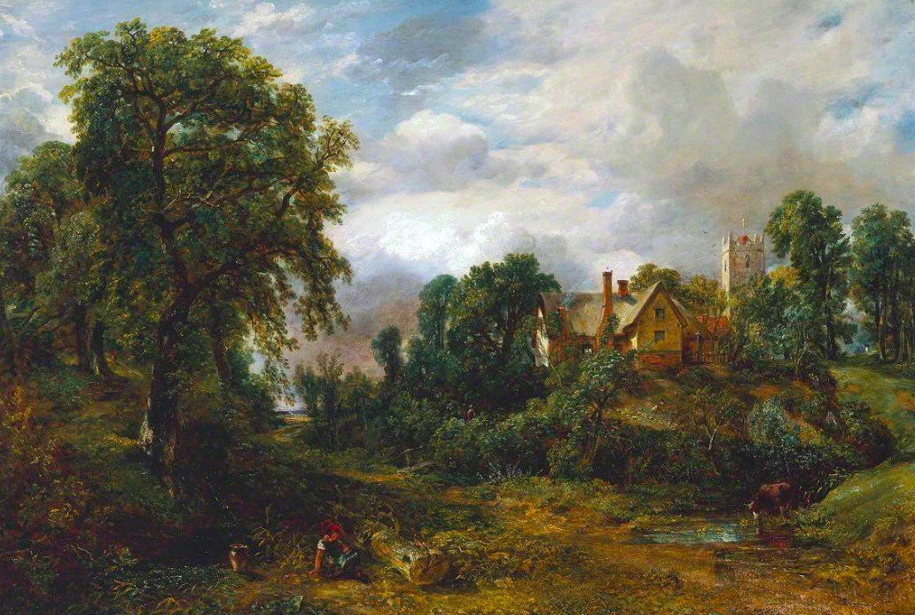
Glebe Farm

Slide 20
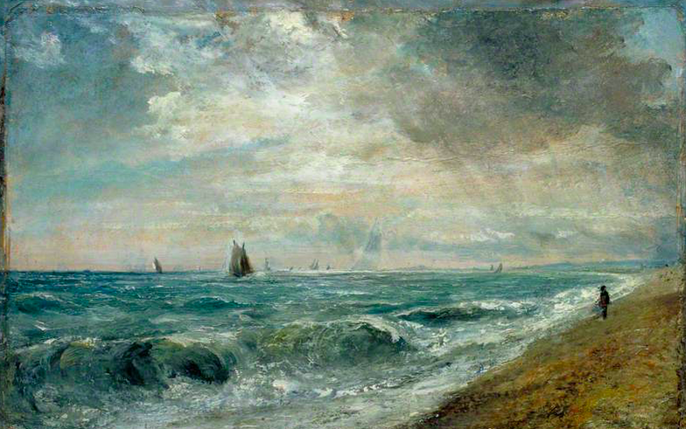
Hove Beach

Slide 21
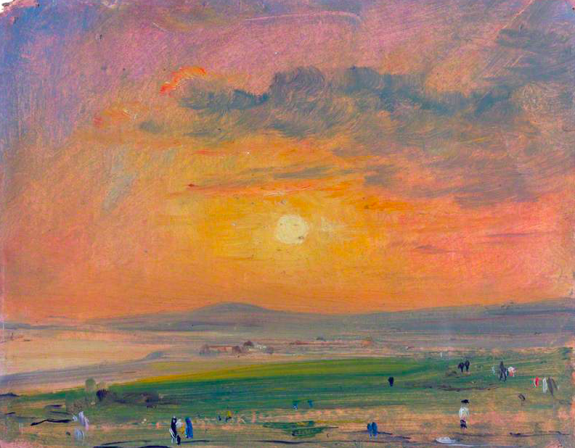
Coast scene at Brighton, evening.

Slide 22
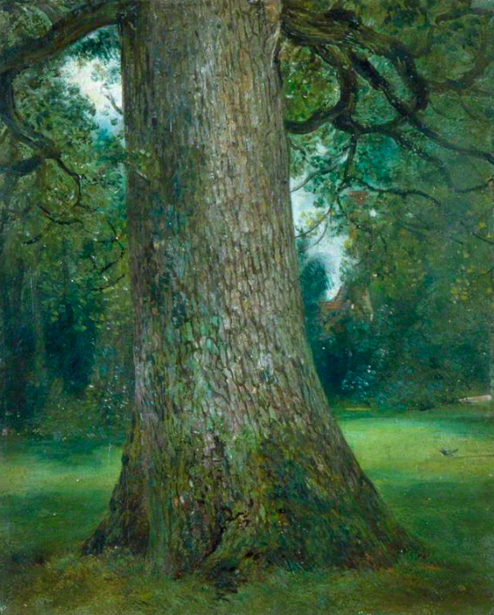
The trunk of an Elm tree.

Slide 23
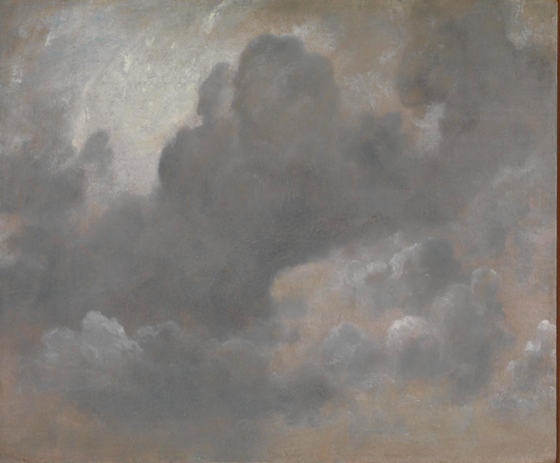
A study of clouds.

Slide 24
https://www.youtube.com/watch?time_continue=4&v=aJVLyuk2cxI
Watch from 7.52 to 8.30 to show some parts of the painting
in detail.

Slide 25
FACTS
Paintings at the time were not of ordinary things like clouds, weather and trees. Constable painted things he remembered from when he was a boy.
The Haywain is 6 feet across! It is huge!
You can see it in the National Gallery in London, although it has
travelled to France.
6 years ago – one of constable’s paintings sold for £22 million.
During his life the most one of his paintings sold for was £300.
Constable is the first painter of his time to use clumpy brush
marks and build up layers of colour, leaving some in the background
shine. Painting at the time was very neat and tidy. Monet and the
Impressionists follow his example.

