Slide 1

Welcome Parents of Foundation Stage children
Learning together in God’s Love

Slide 2


Rights Respecting Schools (RRS)
We are proud to be a Gold Rights Respecting School.
This reinforces our message of being Ready, Respectful and Safe.
Pupils are taught about their Rights as human beings and how we can ensure these rights are met at our school.
Pupils will learn about their rights in assemblies and class reflection time.
The School council and Eco council will help to highlight the importance of these.
Updates on our Rights Respecting Schools journey will be found in our School Newsletter.

Slide 3
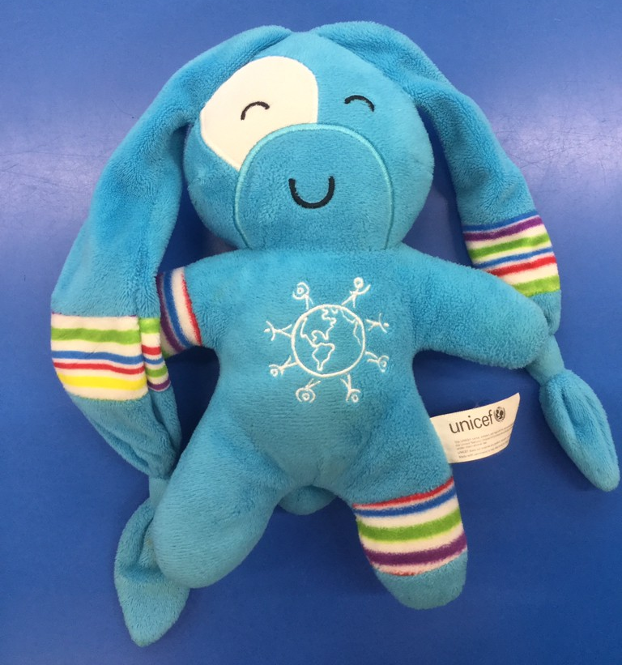
Ricky Rights
Once a week we will choose a child to take home Ricky, our Rights Mascot.
Please spend some time exploring different rights with your child and completing a page in the diary. This can be photos, writing or drawing.
The children will be able to share their adventures in class.
There is some guidance in the front of the diary to support you with this.

Slide 4
Areas of learning
There are 8 different areas of learning in Early Years.
RE
3 Prime areas – C&L PD, PSED
4 specific areas – Literacy, maths, UW, EAD
We have a learning wall displayed clearly in the classroom where our learning objectives are displayed.
Learning Intentions : Our learning intentions will be emailed to you or can be found on our website every Friday. Look out for the
Home Learning Challenges to complete with your child at home.

Slide 5
Daily routines in Early Years
Self registration
Assembly then Activate
Whole class learning- Phonics
Independent learning – Guided activity
PIT STOP Home Learning / Reflect and review
Independent learning – Guided activity
Whole class learning- Maths
Afternoon input – Other areas of learning EAD,PD,UW,RE,C&L
(PE will be every Wednesday. Please come to school in your PE kit every Wednesday. No ear rings are allowed for PE.
FS will be every Thursday. Please come to school in your FS clothes.)
Independent learning
Handwriting
Snack/Playtime/Song/Storytime/Home

Slide 6
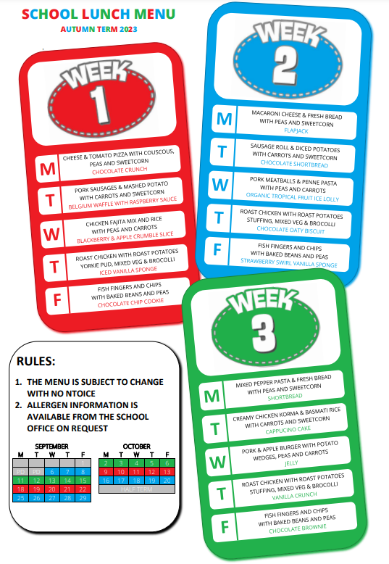


Food
Please remember to send your child to school with a water bottle that contains WATER!
You may also send your child to school with a piece of fruit , vegetables, plain crackers or cheese for their afternoon snack in class in a named container. NO BISCUITS, YOGHURTS, CHOCOLATE or NUTS.
You can find the school dinner menu on the school website.

Slide 7

Lost Property
Please ensure that EVERYTHING is labelled with your child’s name including; uniform, coat, water bottles and lunch boxes.
Spare clothes – Please have some spare clothes in your bag in case of any toilet accidents.

Slide 8
Positive Recognition Board
Each week we focus on a different learning characteristic.
These are resilient, independent, resourceful, inquisitive, faithful, collaborative, respectful, ambitious, motivated, confident.
A hand of success in is given in Friday assembly for achieving the learning characteristic.
The children will be in a House team named after a Saint. Children will receive house points if the child is showing that they are ready, respectful and safe.
To get in the pot of gold the children need to do something that is ‘Above and Beyond’ to get a golden ticket. A ‘Wow’ moment!

Slide 9

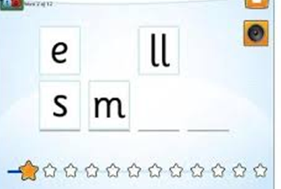
Sounds Write Phonics
Scheme used across the school from EYs to Y6
Children are taught to listen to sounds in words and
then taught the spellings that make those sounds
Focuses on precise pronunciation, sounds taught in context of words and not in isolation, no pictures or actions to represent sounds, no teaching of rules
Teaching sequence constantly builds on prior knowledge and gives time to rehearse and practise
Phonics drop in – Tuesday 17th October 9am
Notes:
Teach children starting with sounds – children listen for sounds in words and then learn the spellings that represent them.
EY – alphabet code knowledge
Y1/2/3/4 – alternative spellings for sounds and polysyllabic words
Y5/6 – explicit teaching of spelling and analysing words
Explain precise pronunciation and how the chn are explicitly error corrected to ensure that this is the case. Be mindful particularly of sounds /q/ /w/ /y/

Slide 10


Reading
Children will bring home decodable books after half term to practice the sounds that they have been taught in school. Please ensure your reading folder has been sent back to school if you haven’t already done so. Books will be changed every Monday.
Books they bring home will be practising words they already have seen and learnt
“Say the sounds and read the word”
Notes:
Y5/6 PLEASE TAKE OUT THE FIRST BULLET POINT
Y3/4 PLEASE ADD SOME
Decodable books – not to take home and learn but to practise what they have already learnt and practised.
No such thing as over learning!
Phrase used in school is “say the sounds and read the word” - important for children to say the sounds in each word

Slide 11
How to support your child at home
If your child makes a mistake, repeat the phrases above and/or point with your finger to the error to see if they can fix it themselves
Say the sounds and read the word.
Say the sounds and write the word.
Notes:
We use these phrases in school so using these at home would help the children hear the same message.
Regular practise is important so aim for a minimum of four times a week for reading and spelling.

Slide 12
Sounds Write Information Evening to be held next half term
Date to be confirmed.
Notes:
Particularly useful for parents/carers of children who have just started and parents new to the school.

Slide 13

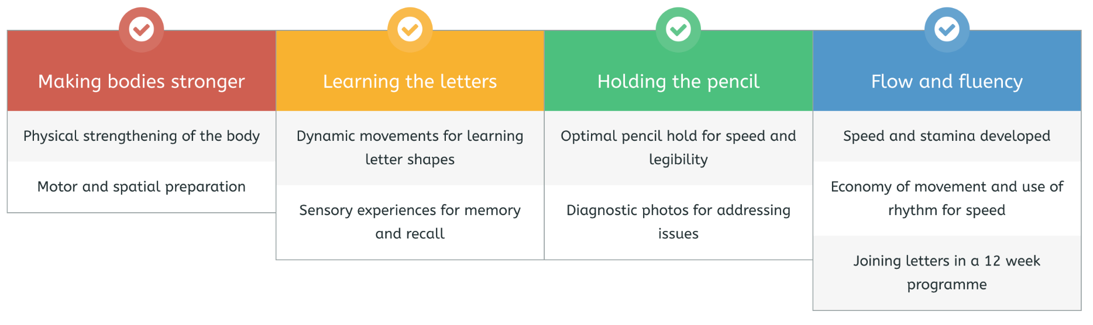
Handwriting Scheme
New scheme introduced across the federation.
Daily 20-minute sessions
4 strands of learning in each session to create fluency and automaticity in handwriting.
Kinetic Letters Parent Workshop: Thursday 16th November 2.15pm

Slide 14

Tapestry
Tapestry is our easy-to-use online learning journal.
It enables both teachers and parents to record, track and celebrate children's progress in early years education.
We will be starting soon so please login and celebrate your child’s achievements together.
We would love you to share with us any special moments at home so we can celebrate them in school too.
If you have any messages about appointments or changes in pick ups please let the office know. Tapestry is for communication about learning only, all other messages must go via the office.

Slide 15


Mathletics and Numbots are our Maths Online learning Programmes. The log on details will sent to you in the form of a letter.
We will start with introducing Numbots after half term and Mathletics after Christmas.

Slide 16

Why do we do
Forest School?
Forest school helps our confidence to grow.
Forest school helps us to make positive relationships and work well with each other.
Forest school gives us time to think about how we and others are feeling.
Forest school enables us to take risks.
Forest school encourages us to care for the environment.

Slide 17
What your child will need in Forest School. Forest School will be every Thursday!
Old clothes
Spare clothes
Wellies in a bag
Inside shoes
Water proof clothing eg coat and trousers
Layers of clothing
Hat gloves
Sun hat

Slide 18
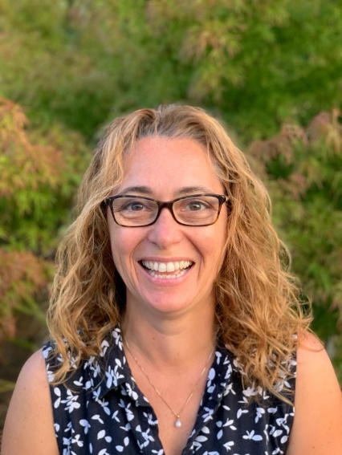
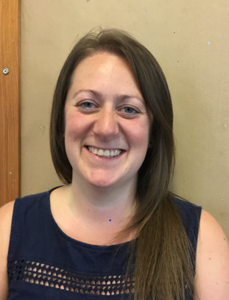
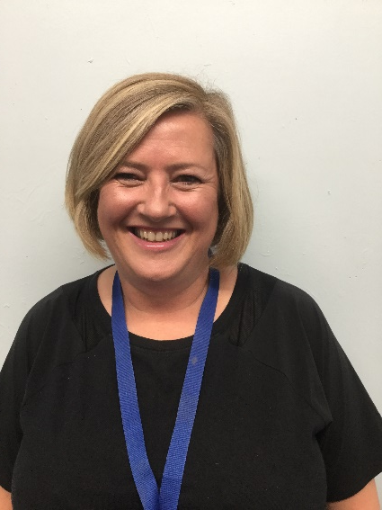
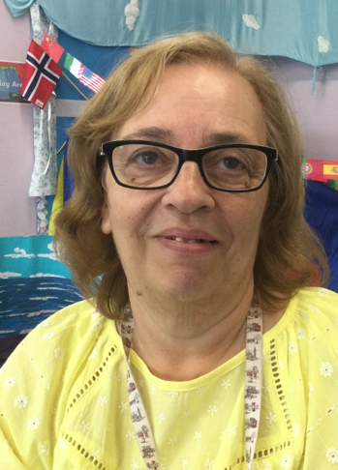
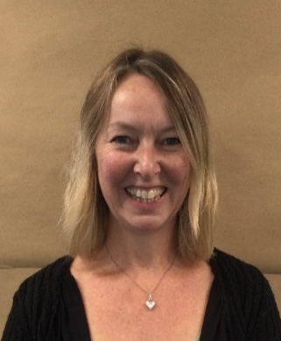
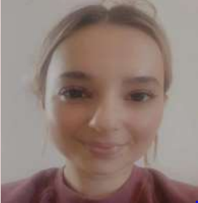
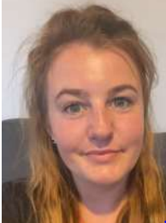
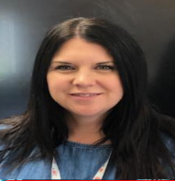
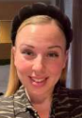
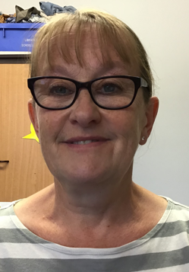
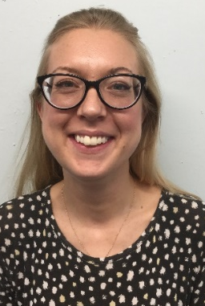
Thank you from the Early Years Team.
Mrs Masetti
Mon, Tues, Wed
Mrs Jackson
Wed, Thurs, Fri
Miss Eden
Mon, Tues, Wed, Thurs, Fri
Miss Pite Mrs Cassidy Mrs Lloyd Miss Maran Miss McGuire Mrs Marris Mrs Shaw Mrs Vince
M, T, Th, F T, W, Th, F M, W, F M, T, W, Th, F M, T, W, Th, F M, T, W, Th, F M, T, W Th

Slide 19
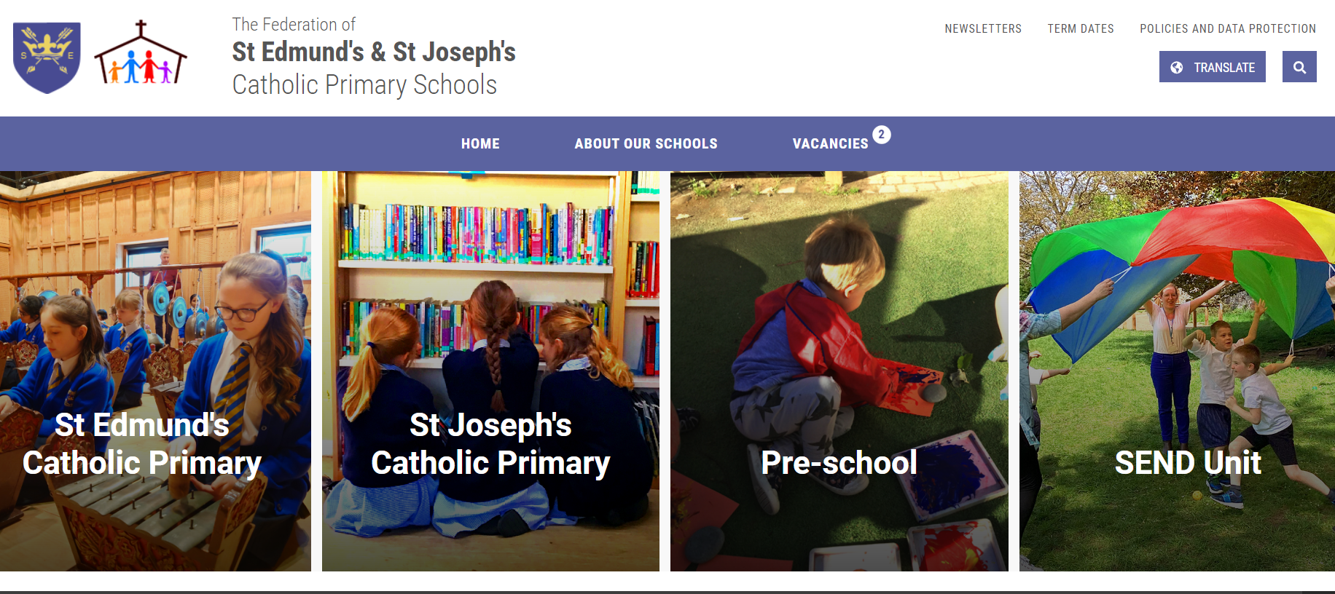
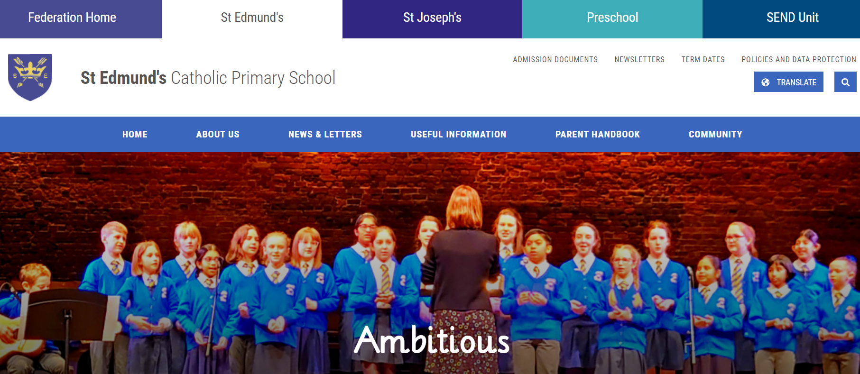
Extra help
Contact the office in person or via email and they will pass on relevant information to us. office@st-edmunds.suffolk.sch.uk
Look at the school website www.st-edmunds.suffolk.sch.uk
useful information and parent handbook sections

