Slide 1

St Joseph’s Roman Catholic Primary School
Noah Class – Reception
Early Years Foundation Stage
Welcome Presentation 2024/25
‘Encourage and Support’

Slide 2
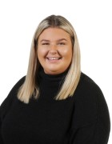
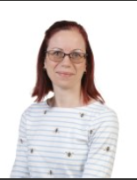

Meet the staff in Reception:
Miss K Robinson Mrs E Eady Mr Ian Frost (Maxim Sports)
Class teacher Teaching assistant (Thursday am – PPA cover)

Slide 3




Positive recognition
Positive recognition boards in every classroom with weekly focus;
Positive play cards;
Hand of success;
St Joseph’s wall of fame.

Slide 4

Ready, Respectful, Safe
At St Joseph’s we are ready, respectful and safe.
Displayed around the school and in each classroom.

Slide 5
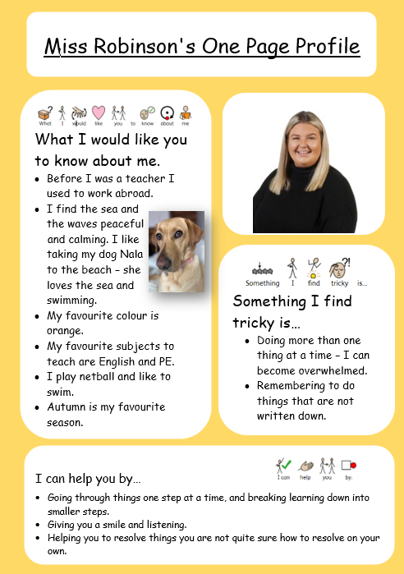
Miss Robinson’s
One-Page Profile
All members of staff have completed a one page profile. These can be found across the school.
The purpose of these is for the children to familiarise themselves with staff, and so they get to know a bit about us.

Slide 6


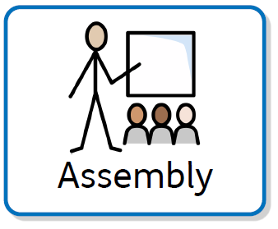

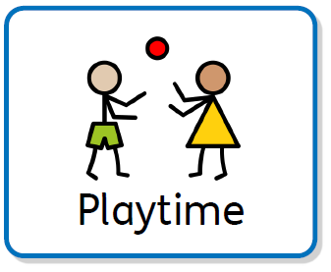









Timetable in Reception
The middle gate opens at 8:40am at drop off and 3:10pm at pick up.
Daily
Weekly

Slide 7

Sounds Write Phonics
Scheme used across the school from EYs to Y6 – daily lessons in EYFS
(alphabet code knowledge, alternative spellings, polysyllabic words)
Children are taught to listen to sounds in words and then taught the spellings that make
those sounds
It focuses on precise pronunciation, sounds taught in context of words and not in isolation,
no pictures or actions to represent sounds, no teaching of rules
Teaching sequence constantly builds on prior knowledge and gives children time to
rehearse and practise

Slide 8

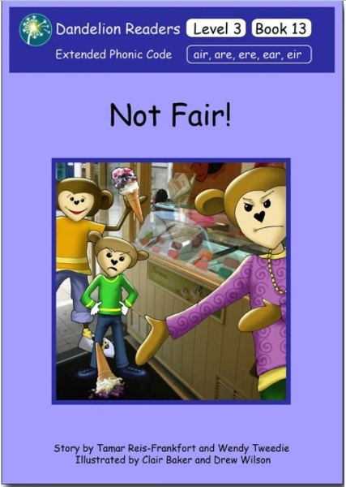
Reading
Children will bring home decodable books to practise reading words with the sounds they have been taught in school
Children will have been explicitly taught sounds and will have practised reading and writing these in the classroom
Reading books give the children opportunities to practise words they have already seen and learnt

Slide 9
How to support your child at home
If your child makes a mistake, repeat the phrases above and/or point with your finger to the error to see if they can fix it themselves
On the weekly messages there is some spellings listed which we will be covering in phonics that week. Please note that children in reception are not tested on spellings, this is more just for your information and to practice them at home.
Say the sounds and read the word.
Say the sounds and write the word.

Slide 10

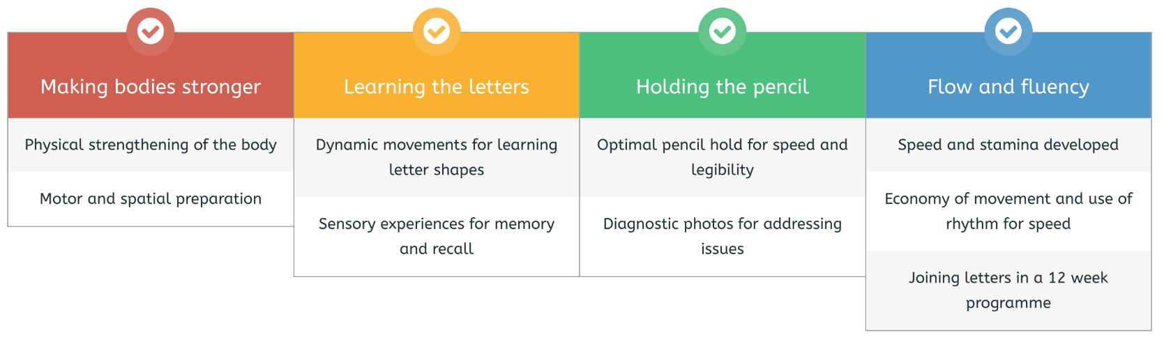
Handwriting Scheme
Daily 20-minute sessions
4 strands of learning in each session to create fluency and automaticity in handwriting.
You will receive a home pack with information about Kinetic Letters, and practice sheets when letters are introduced.

Slide 11



Online Maths Programmes
For new Early Years children, Numbots will be introduced next half term.
Your child should complete a minimum of 10 minutes a week on either Numbots (Early Years to Year 3) and / or TTRS (Years 1 to 6)
Mathletics is introduced in Spring 1 for Early Years children. Children will be sent home with a QR code to log in.

Slide 12

What should my child bring to school each day?
Your child should bring these items into school each day:
Coat (named);
Packed lunch (unless school dinners); this should be a healthy packed lunch with a sandwich/wrap/pasta, and variety of other healthy options such as fruit and yoghurt.
A healthy snack (this is provided by the school, but some parents wish to provide their own.)
A St-Josephs RC Primary School draw-string bag containing a;
Water bottle containing only water; and
Reading folder.

Slide 13
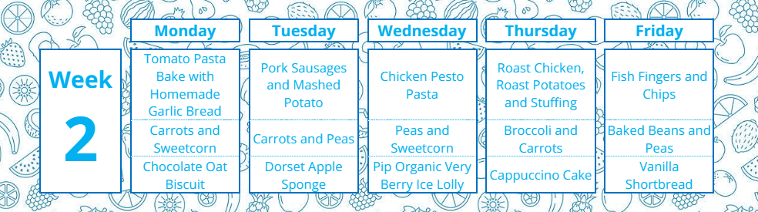
Universal Free School meals in EY and KS1
In Reception your child qualifies for a free school meal. As a school we encourage children to try the lunches. If you wish to provide your child with a packed lunch then this is also more than fine. The lunch menu is available on the school website. Go to ‘parent handbook > lunches’

Slide 14


Tapestry
Account activation email has been sent by the school office – has everyone got access?
Tapestry is an online learning journal which your child’s class teacher uploads to. We aim to keep you involved in your child’s education and will upload to tapestry to keep you up to date with learning and our achievements in school.
Parents are able to view online their child’s progress and how much fun they’re having, whilst also uploading their own comments and media.
Home learning should be submitted via tapestry.
Notes:
Bullet points of key info- the rest can be explained prally

Slide 15
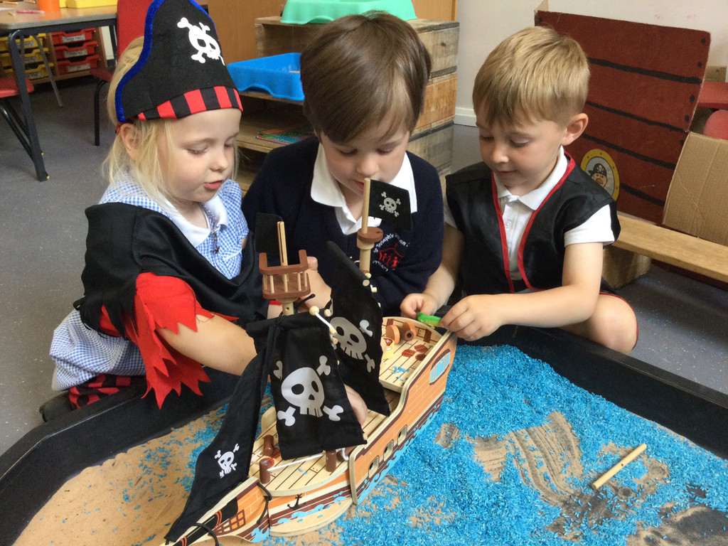
Parental partnership - drop in’s and learning conversations
At various points in the academic year, you will be invited to a parent drop-in session, where you can observe teaching and complete activities along-side your child.
Each term we hold evening learning conversations with your child’s class teacher to discuss their progress in reception, and any next steps, you will also receive a one-page summary of discussion prior to the meeting.
Drop in dates: TBC
Notes:
BUllet point key info

Slide 16
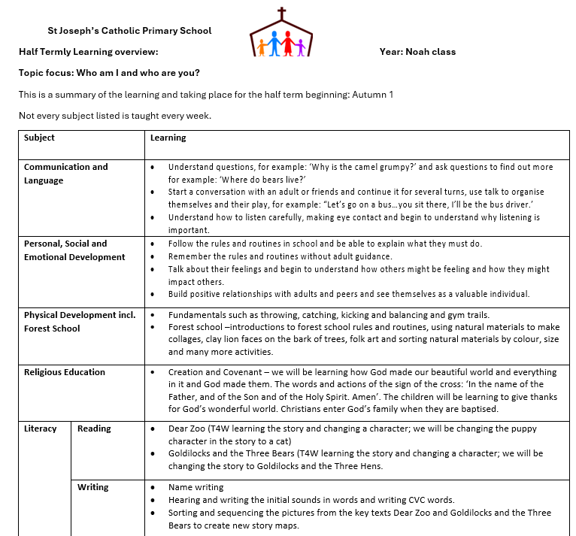
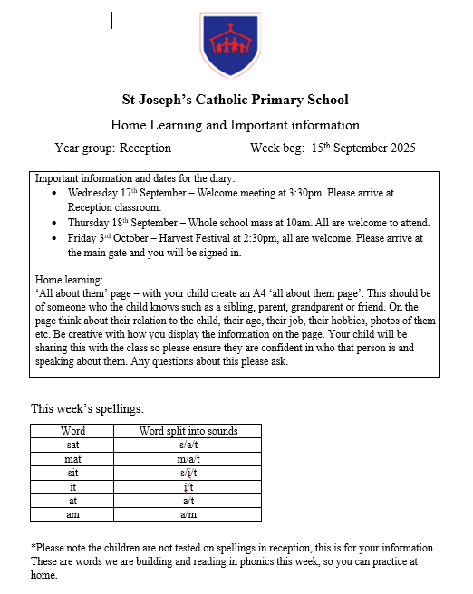
Half termly overview
Weekly messages

Slide 17
Physical
Development
PE will be being taught by Mr Frost and colleagues from Maxim Sports on Thursday.
PE kit – Please come into school in PE kit only on Thursday’s (Earrings to be removed on PE days)
Focus on making bodies stronger (red thread) to support strength, core, stability and pelvic/shoulder girdle strength.
Physical development is both gross and fine motor skills. To support children’s fine motor skills we have the kinetic letters boxes (red, yellow and green) to support hand/finger targets (whole hand/all fingers/3 friends) to develop the small muscles within the hand and enable advanced fine motor coordination.
Things you can do to help at home: use malleable materials with your child that they can squeeze, twist and poke such as pegs, tweezers/tongs, playdough, pom-poms, beads/beans, stretchy bands.
Please ensure that all items of uniform are labelled clearly to make lost items returnable.
Notes:
Talk about earrings
Only have kit on days for PE
what days, still some places in clubs

Slide 18
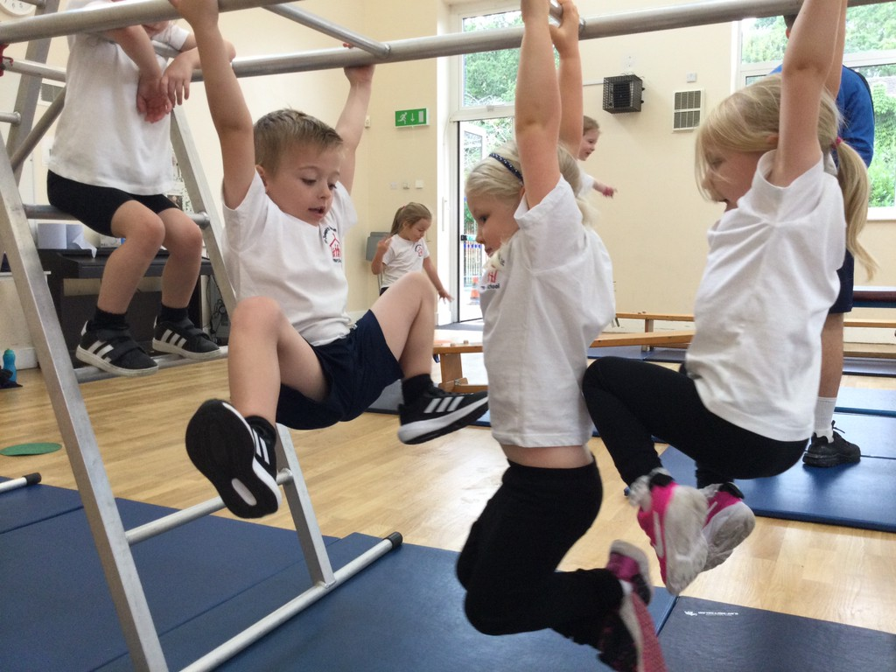
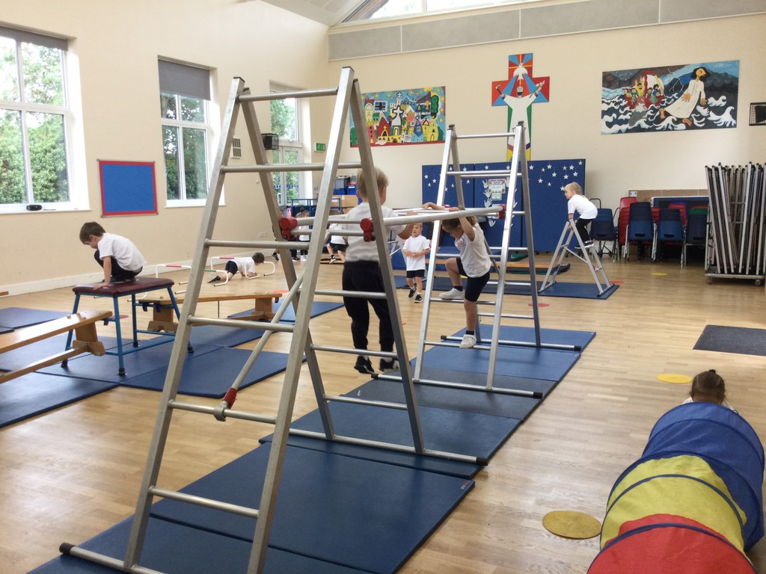
Gym Trail to support Gross Motor skills
- You need to be strong for writing!

Slide 19
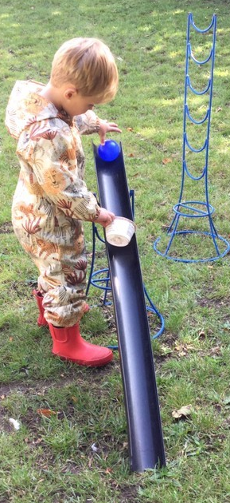
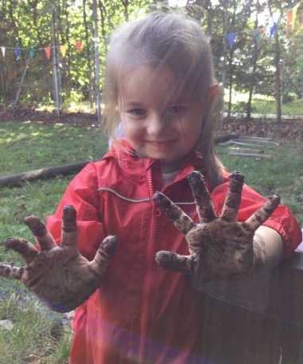
Outdoor learning
Forest school is on a Friday afternoon. Please make sure your child comes into school in:
Joggers or leggings
Jumper or hoodie
Waterproof coat/All-in-one suit
Wellies or old trainers (in a separate bag)
Forest school allows us to promote the
children’s learning outside and encourages risk taking and offers opportunities development of gross motor skills and connecting the children to nature.
Notes:
Could this be renamed outdoor learning?

Slide 20
Other information
Please make sure that all children’s coats, jumpers/cardigans, bags, water bottles, lunchboxes are labelled with their name.
Children are allowed to bring in their own snack, this should be a piece of fruit, or there is snack provided daily by the school. Children should only have water in their water bottle, milk is provided until the age of 5, if you wish for your child to continue having milk once 5, there is a small fee.
Weekly messages and half termly overview
Notes:
Self / peer assessment – how it works

Slide 21
Extracurricular clubs
Monday - dance with Maxim sport in the hall (finished 4.20pm - playground gate pick up)
Tuesday - dodgeball with Maxim sports in the hall for year 1 -3 (finishes at 4.20pm - playground gate pick up)
Wednesday - gymnastics with S4sports in the hall for year 1-6 (finishes at 4.30 pm and pick up at playground gate)
Friday - Dodgeball with Maxim Sport for year 4-6 in the hall or school field - weather permitting (finishes at 4.20pm from the playground gate.

Slide 22
Online Safety:
Helping to keep our children safe online
Reminders:
Be involved in your child’s online life - Consider what parental controls you have in place at home to filter inappropriate content. Do you monitor your child’s online activity? Do you check the privacy settings on tablets, phones, laptops? Are the devices your child uses kept in a communal space in the home so you are aware of what they are accessing?
Limit your child’s time spent online to support the development of healthy habits (especially before going to bed)
Have you talked to your child about what to do if they feel unsafe online? Not everyone is who they say they are.
Are you APP aware? - Age restrictions – most social media apps require children to be 13+ to access them. (TikTok, WhatsApp, Instagram, Snapchat, Discord etc)
Only children in Year 6 are permitted to bring a phone to school (if they are walking home). These are handed in to the office for safe keeping during the day. No access to these is permitted whilst in school.
We ask that children do not wear smart watches to school. Notifications cause a distraction from their learning and online connectivity could pose a risk to themselves and others when in school. Any smart watch worn to school will be stored in the office, as per mobile phones, and these will then be available to collect at the end of the school day.

Slide 23
Questions?
I appreciate there has been a lot of information regarding your child’s start to school, however if you have any questions now or throughout the academic year please get in touch.
Useful ways to contact me:
Email at admin@st-josephs.suffolk.sch.uk
Tapestry
If I am available, you can speak to me on the gate.
I look forward to working alongside you this academic year to support your child.

Slide 24
Thank you for attending.
Any further questions please ask.

